Slide 1

RuleMatrix: Visualizing and Understanding Classifiers with Rules
Authors:-
Yao Ming
Huamin Qu
Enrico Bertini
Q&A
Introduction
The pipeline
Visualization Methods
Rule Induction
About
Presented By:-
Gautam Saini

Slide 2
A tool for understanding and inspecting machine learning model
Target users: domain experts with little knowledge about machine learning mode such as Doctors, Analyst
Risky to deploy neural network for decision making for real patients because of lack of transparency
Q&A
Introduction
About
The pipeline
Rule Induction
Visualization Methods

Slide 3
Rule- Based interface (IF THEN ELSE)
Extract rules based knowledge from black box trained neural network
Construction of rule matrix from given black box classifier.
Exploration of data used in training the model.
About
Q&A
Visualization Methods
About
The pipeline
Introduction
Rule Induction

Slide 4

1
2
3
Visualization for model Analysis
Model Induction
Representation
Approximation of any machine learning model
Simplified representation from structure
Understanding and refinement of machine learning model
Rules extraction for models
Rule based models are composed of logical statements
Rule based matrix presentation
Includes filters
IF-THEN-ELSE statements representation
Q&A
About
The pipeline
about
Rule Induction
Visualization Methods

Slide 5


Visualization Steps
Q&A
Introduction
Rule Induction
about
The pipeline
Input
Approximate Rule List
Visualize rule list
Training data
Model to explain
A rule list that Approximates original model
Filter rule list according to user specified criteria
Rule list is visualized as rule matrix

Slide 6
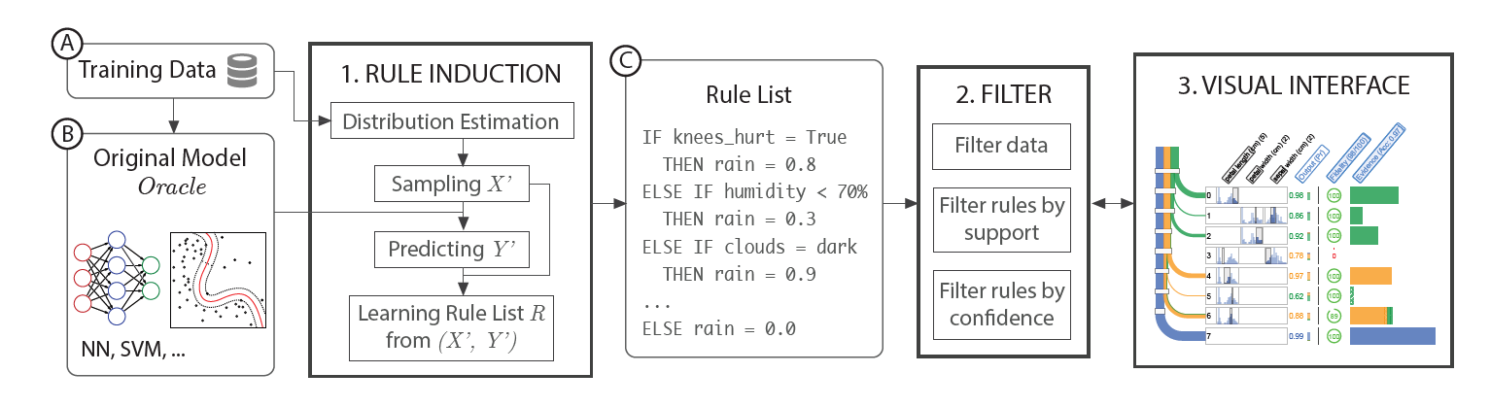
Visualization Steps
Q&A
Introduction
Rule Induction
about

Slide 7
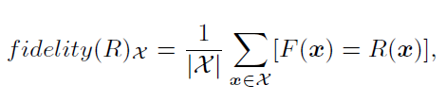
01
02
03
Rule Induction
Fidelity
Estimation Distribution
Rule Induction
Extracts rule lists from trained classifier
Input: trained mode and training set
Output: rule list that approximates the classifier
How accurate is the approximation compare to the given trained model
Estimation distribution of input data
Create distribution histogram
Q&A
Introduction
Algorithms
about
Visualization Methods

Slide 8
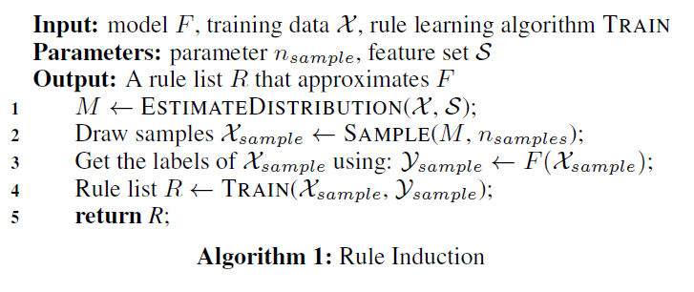
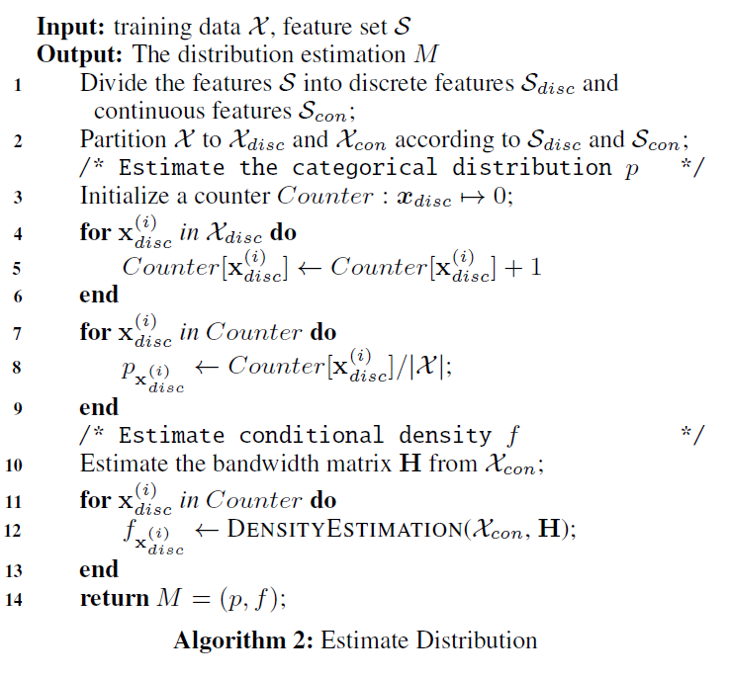
Q&A
Introduction
Rule Induction
Algorithms
about
Visualization Methods

Slide 9
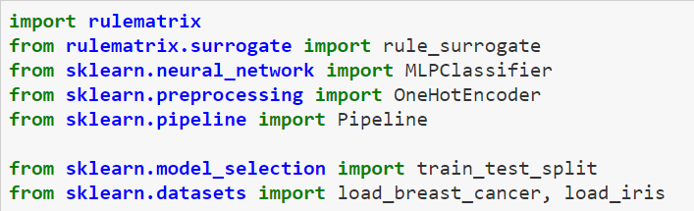

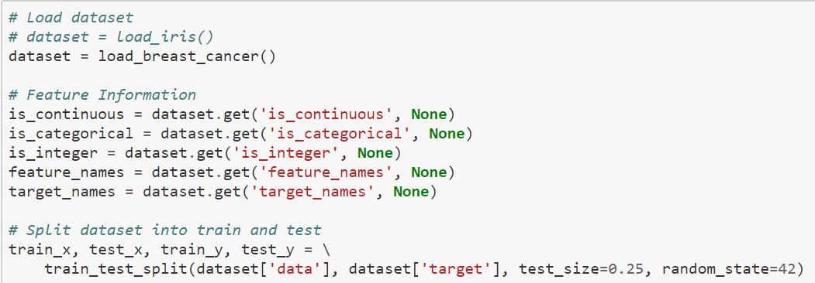

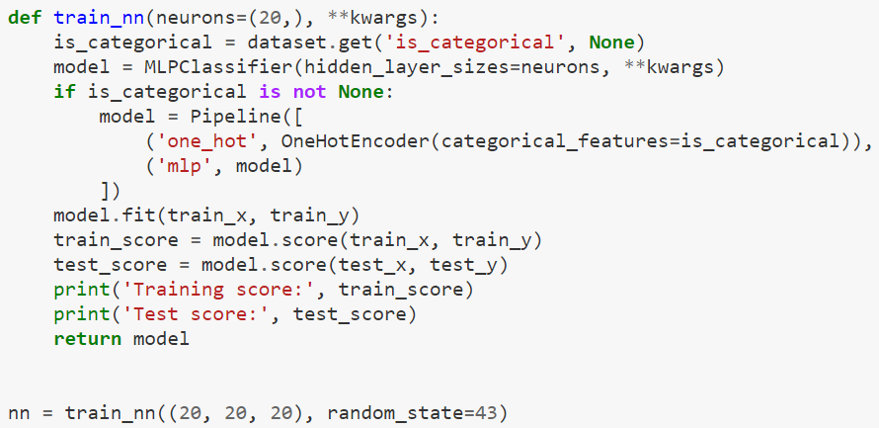

Import
Load Dataset
To make use of the visualization, it's better to provide feature names and target names.
We partition the dataset into training and test set.
Q&A
Introduction
about
Visualization Methods
Algorithms
The visual Interface
Training a Neural Network

Slide 10

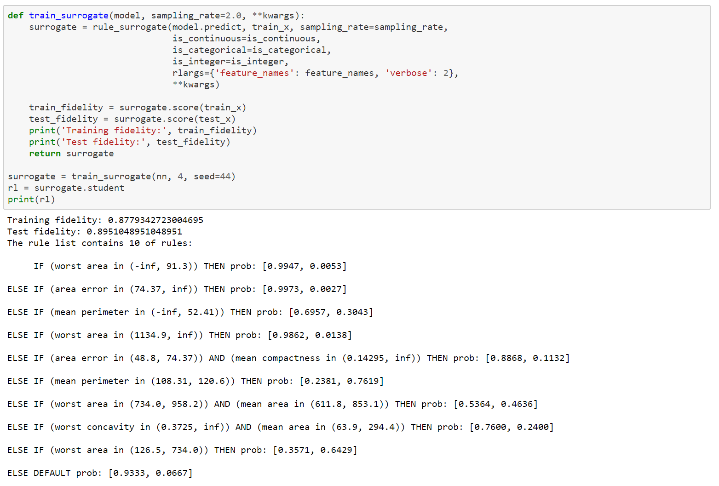
Train Rule Surrogate
Next we train the surrogate rulelist of the neural net, using default parameters, and render the RuleMatrix visualization.
Q&A
Introduction
Algorithms
about
Visualization Methods
The visual Interface

Slide 11

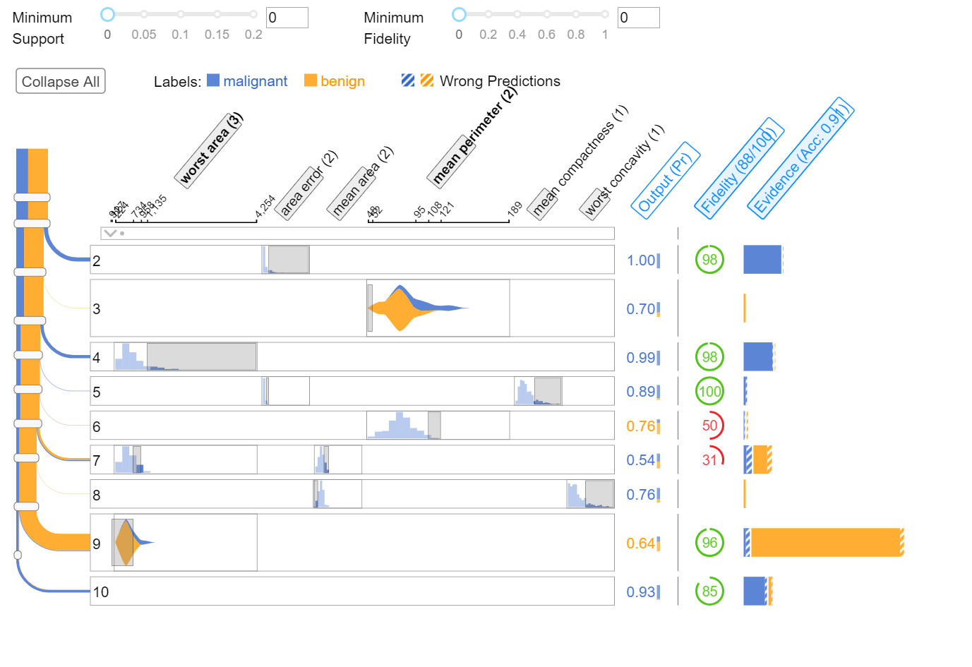
Q&A
Introduction
Algorithms
about
Visualization Methods
Render rule matrix

Slide 12
Each row represents a rule, and each column represents a feature.
The shadowed part in the cell also indicates the value range of the feature used in rule.
The histogram of light blue in the cell shows the distribution of the feature
In the left of the matrix is the data flow, showing how all the data is captured by each of the rules
The width of the flow indicates the number of data captured/uncaptured by each rule
The color of the flow indicates different labels
In the right of the matrix shows detail information about each rule
The stripped part encodes the part of data wrongly classified by the model as a certain label represent by the color.
example, the data captured by rule 9 is mostly benign
example, there are about 1:2 malignant:benign data in the breast_cancer dataset
Q&A
Introduction
about
Visualization Methods
Algorithms
Terminology

Slide 13
Important links:
Rule matrix analysis on cancer dataset
Rule Matrix GIT Hub codes
Q&A
Introduction
about
Visualization Methods
Algorithms
Important Links

Slide 14
Q&A
Introduction
about
Visualization Methods
Algorithms
Q&A
?
Q&A

Slide 15
Thank You
Introduction
about
Visualization Methods
Algorithms
Q&A
Q&A
Q&A

